Slide 1
GLOBAL SUPER STORE ANALYSIS
NAME: EZEUGO PEARL UZOAMAKA
EXCEL|POWER QUERY|POWER PIVOT|MEASURES
PROJECT: JADONS HUB MENTORSHIP PROGRAM

Slide 2
OBJECTIVES
Understand overall sales and profitability
Identify sub-categories that cause losses
Analyze trends to support decision-making
Analyze how to maximize profits and how this affect future decisions

Slide 3
DATA PREPARATION
TOOLS
  Microsoft Excel
  Power query
  Power pivot
  Measure
Dataset
  Professional Identity Architecture - Global Super Store
Tables Created
  Orders, Product, Calendar, Location, Customers

Slide 4
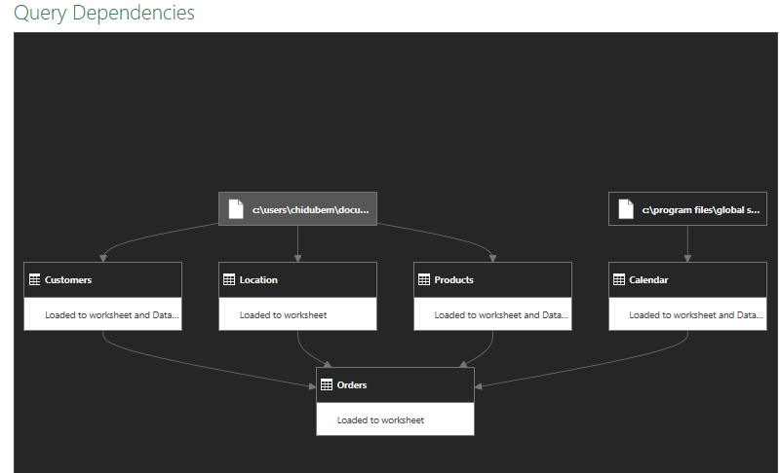
TABLES
Orders, Products, Location, Customers, Calendar

Slide 5
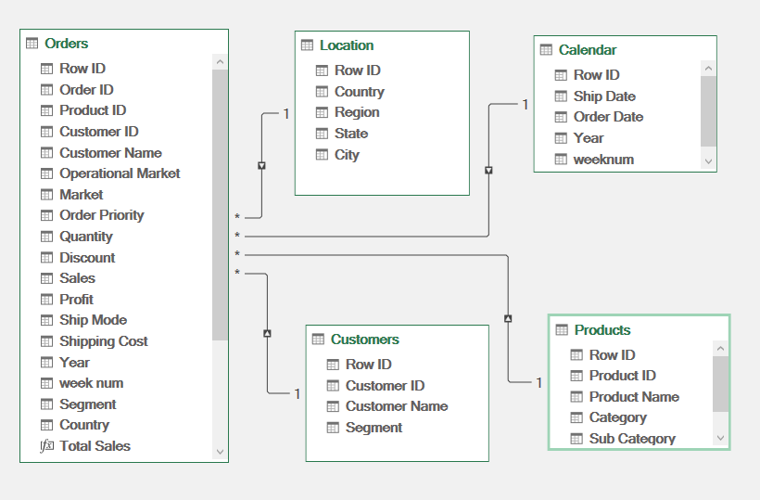
MEASURES
Total Sales, Total Profit, Total Orders, Total Quantity, Profit Margin, Average Discount, Average Shipping Cost

Slide 6
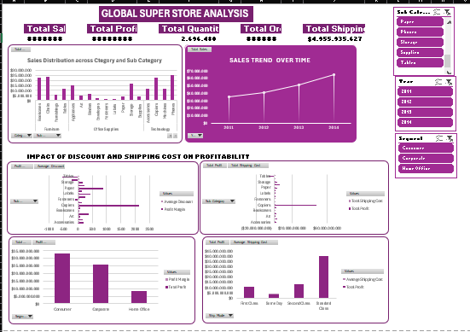
DASHBOARDS
TOP: KPI CARDS
MIDDLE: Sales distribution by
category and sub category
Sales trend over time
Impact of discount on profit
BOTTOM: Prescriptive analysis

Slide 7
KEY INSIGHTS
Sales show upward trend over time which signifies growth
Technology category generates the highest sales; Office Supplies the lowest
Certain sub-categories have high sales but negative profit margins like tables
Higher discounts and shipping costs yields low profitability
Consumer segment drives highest sales, but Corporate segment has better margins

Slide 8
RECOMMENDATION AND CONCLUSION
Review discount policies for low-margin sub-categories
Optimize shipping modes to reduce costPrioritize high-margin customer segments
Focus marketing on high-profit sub-categories

